Slide 1
POLAND
ZESPÓŁ SZKOLNO – PRZEDSZKOLNY
W ORZYSZU

Slide 2
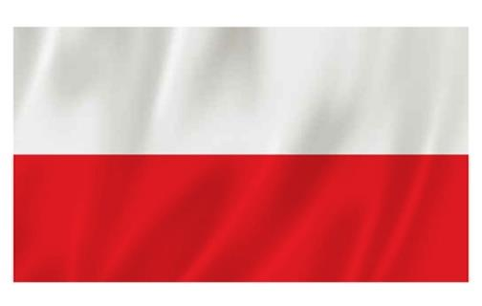
Mazurek Dąbrowskiego
Jeszcze Polska nie zginęła,
Kiedy my żyjemy.
Co nam obca przemoc wzięła,
Szablą odbierzemy.
Marsz, marsz, Dąbrowski,
Z ziemi włoskiej do Polski.
Za twoim przewodem
Złączym się z narodem.
Przejdziem Wisłę,
przejdziem Wartę,
Będziem Polakami.
Dał nam przykład Bonaparte,
Jak zwyciężać mamy.
Marsz, marsz, Dąbrowski,
Z ziemi włoskiej do Polski.
Za twoim przewodem
Złączym się z narodem.
Jak Czarniecki do Poznania
Po szwedzkim zaborze,
Dla ojczyzny ratowania
Wrócim się przez morze.
Marsz, marsz, Dąbrowski,
Z ziemi włoskiej do Polski.
Za twoim przewodem
Złączym się z narodem.
Już tam ojciec do swej
Basi Mówi zapłakany
– Słuchaj jeno, pono nasi
Biją w tarabany.
Marsz, marsz, Dąbrowski,
Z ziemi włoskiej do Polski.
Za twoim przewodem
Złączym się z narodem.
POLISH FLAG
EMBLEM
Notes:
2

Slide 3
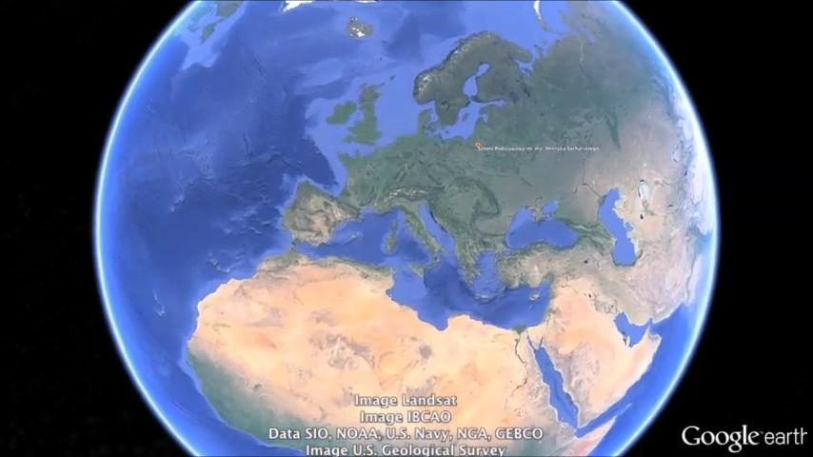

Slide 4
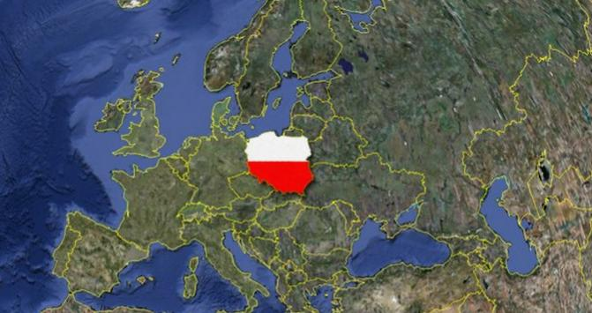
Poland is a country located in Central Europe.
It is divided into 16 administrative subdivisions.
With a population of nearly 38.5 million people,
Poland is the sixth most populous member state of the European Union.

Slide 5
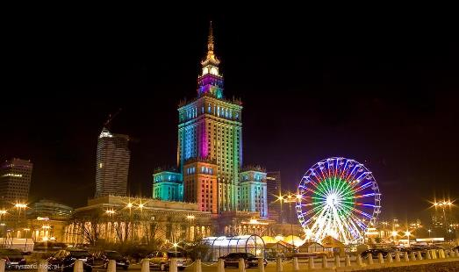
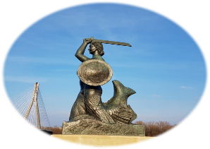
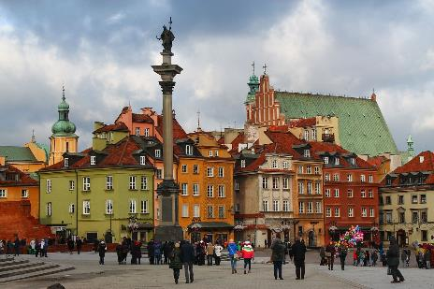
Poland's capital and the largest city
is Warsaw.

Slide 6
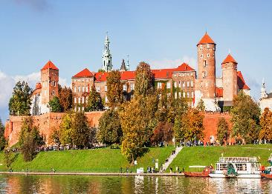
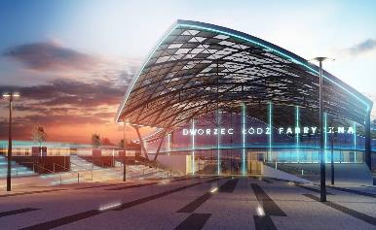
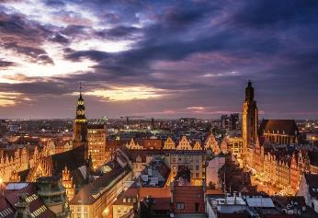
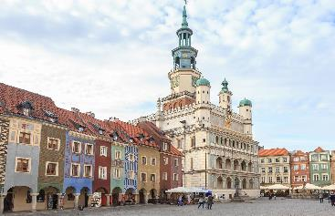
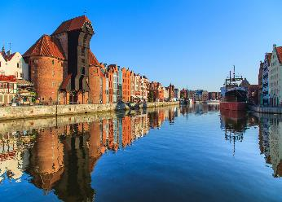
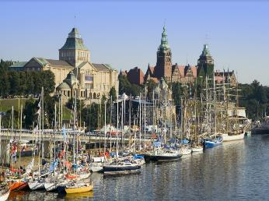
Other major cities include Kraków, Łódź, Wrocław, Poznań,
Gdańsk and Szczecin.
Notes:
6

Slide 7
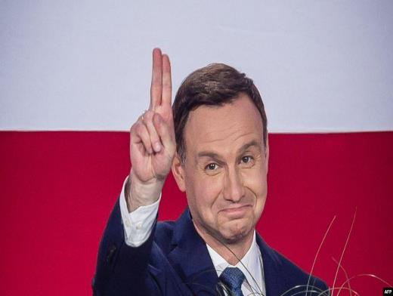
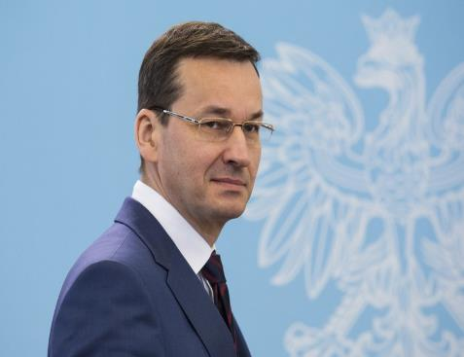
The President:
Andrzej Duda
The Prime Minister:
Mateusz Morawiecki

Slide 8
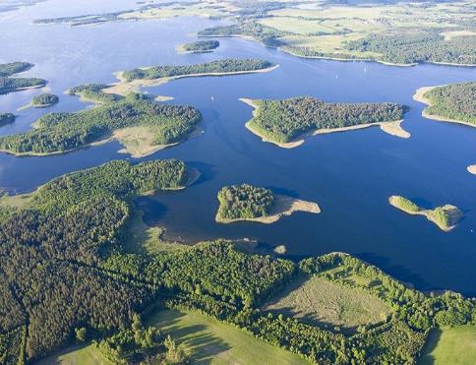
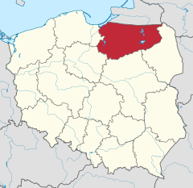
The northeastern region is also known as the Masurian Lake District with more than 2,000 lakes.
Notes:
8

Slide 9
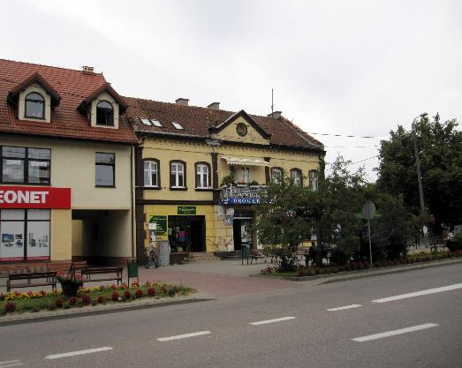
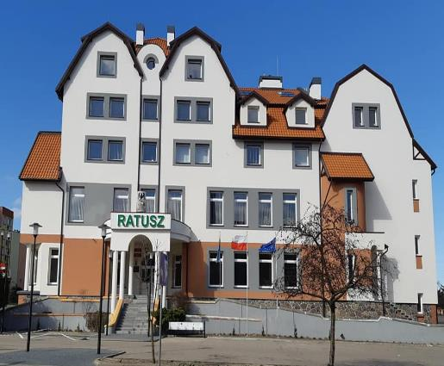
Orzysz is a town in northeastern Poland with 5615 inhabitants.
Notes:
9

Slide 10
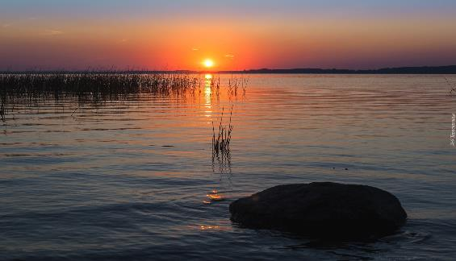
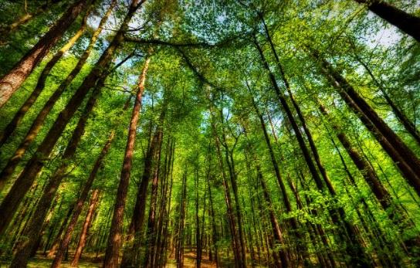
In this region of Poland we have a lot of lakes and forests.
Notes:
10

Slide 11
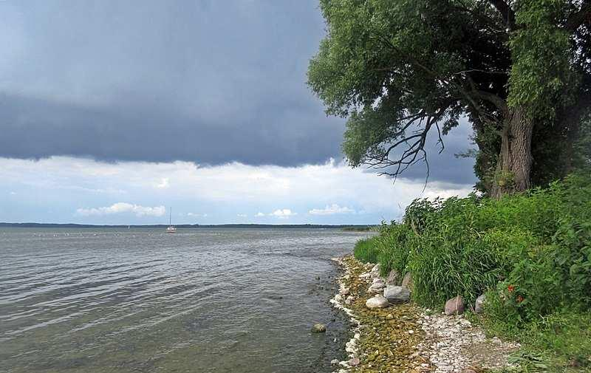
Few kilometres from our town there’s the biggest Polish lake – Śniardwy. It is often called Masurian Sea.
Notes:
11

Slide 12
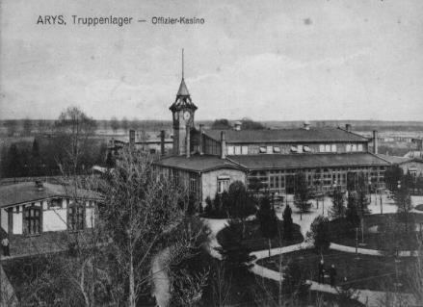
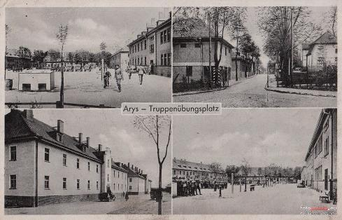
People started living in Orzysz in 1443.
It became a town in 1725.
Notes:
12

Slide 13
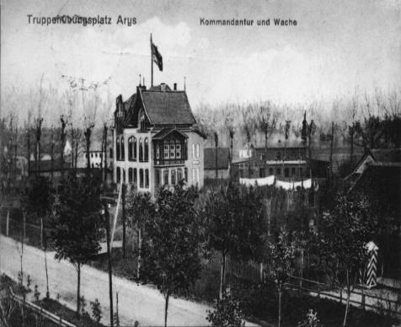
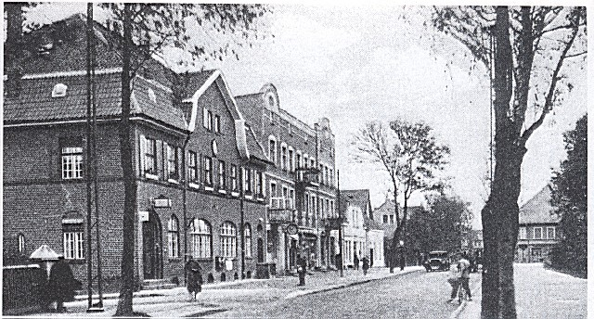
About 60 years later it became a garrison city.
Notes:
13

Slide 14
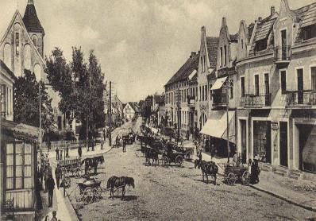
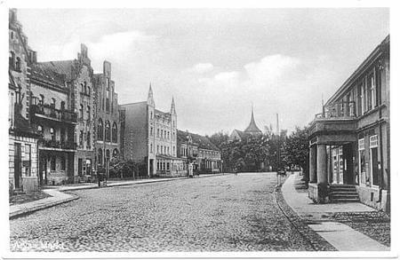
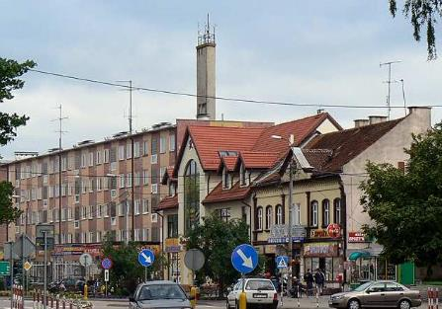
The main street in Orzysz now and before.
Notes:
14

Slide 15
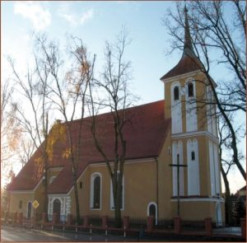
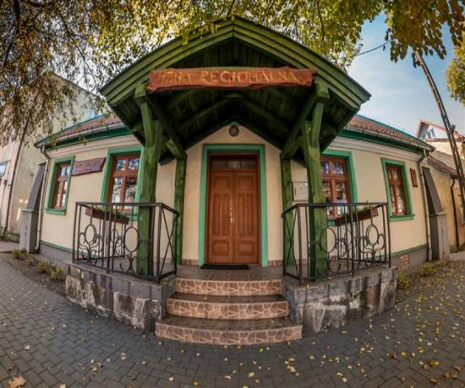
There are many interesting places to visit for example: the old church from 1530 or the military museum.
Notes:
15

Slide 17
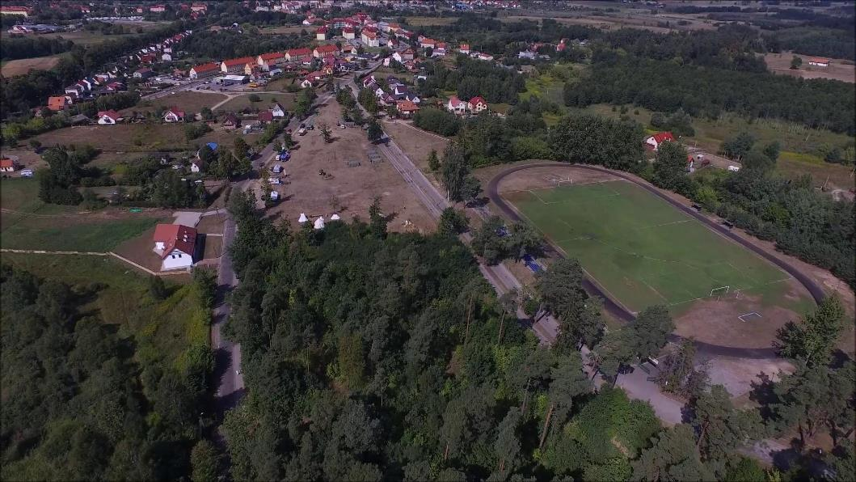

Slide 18
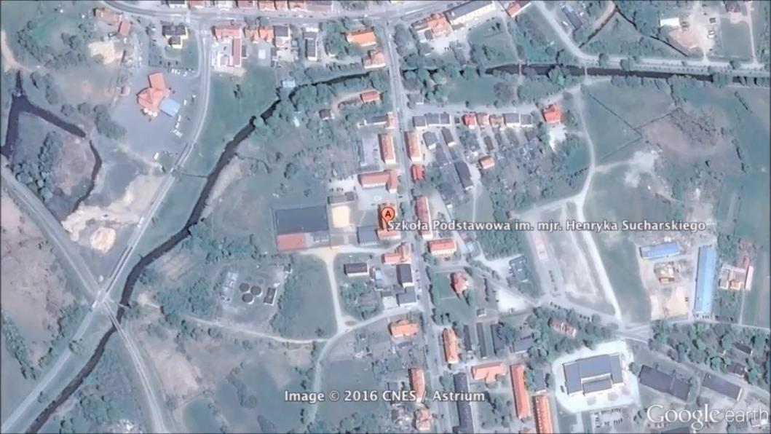
Notes:
18

Slide 19
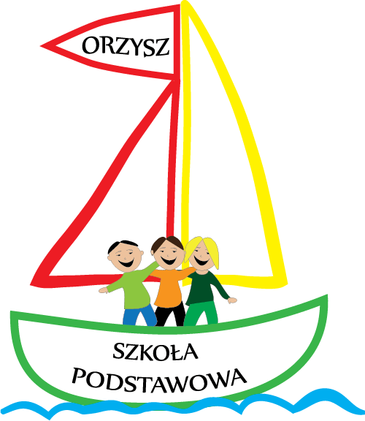

Slide 20
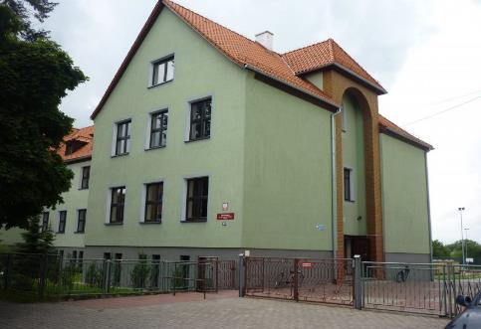
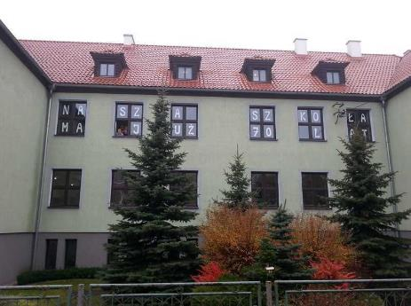
Our school is 74 years old and it is a friendly school. We can learn different languages: English, German and Russian. The students travel a lot around the country and abroad.

Slide 21
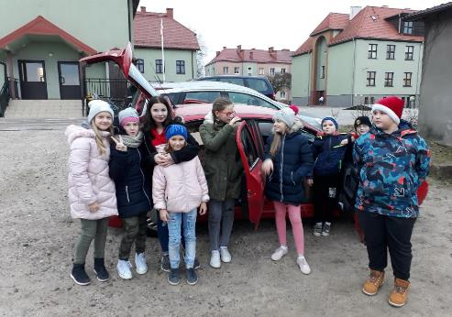
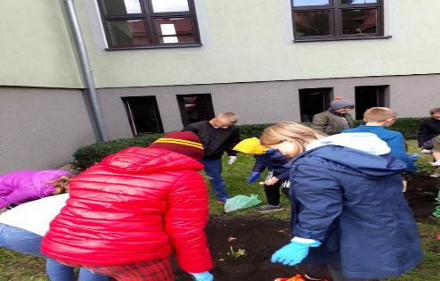
VOLUNTARY WORK

Slide 22
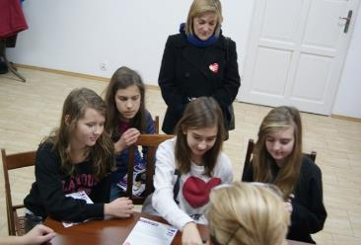
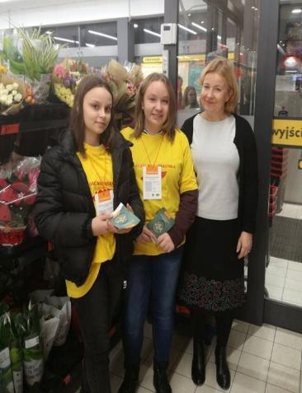
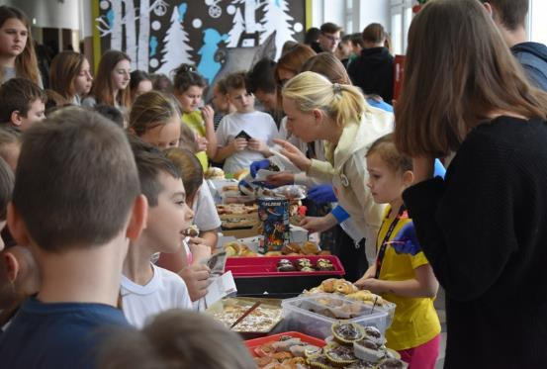

Slide 23
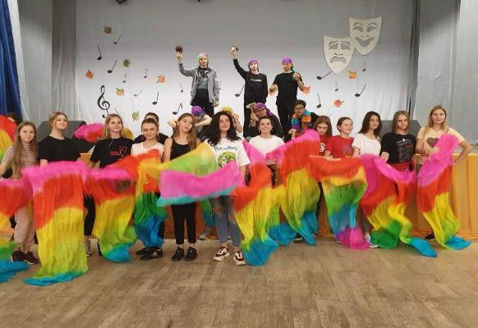
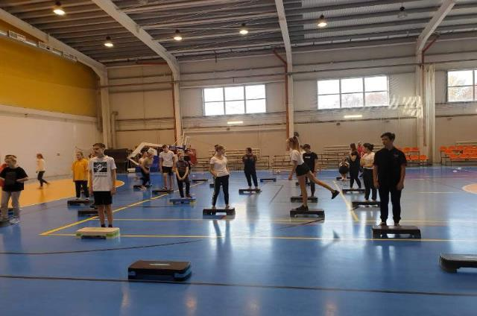
Polish and Russian school exchange.

Slide 24
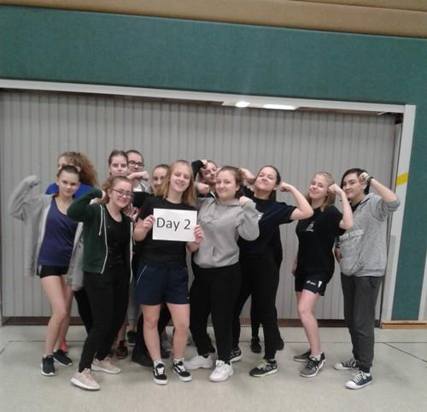
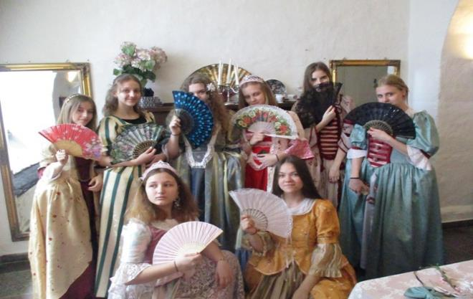
Polish and German school exchange.

Slide 25
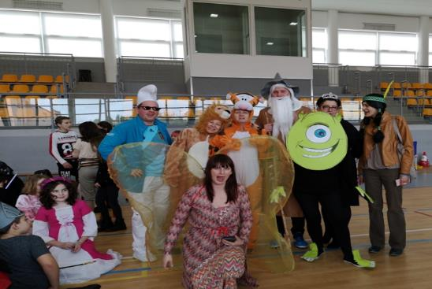
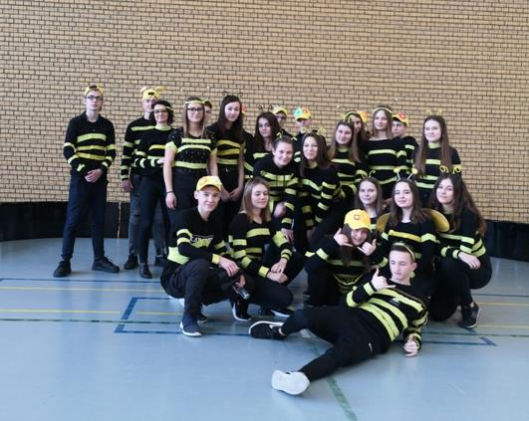
Some days are so funny …

Slide 26
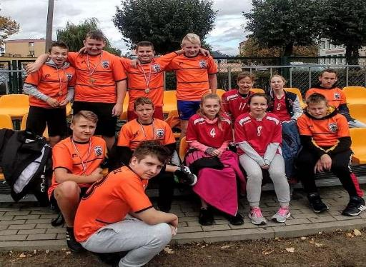
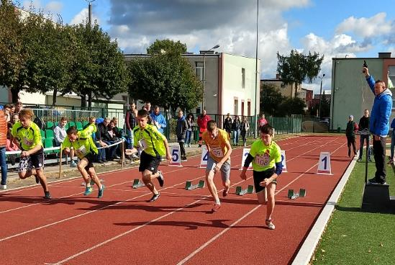
SPORT EVENTS

Slide 27
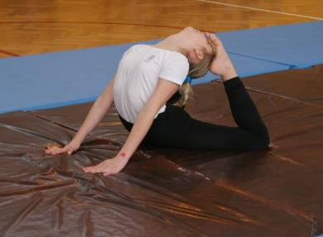
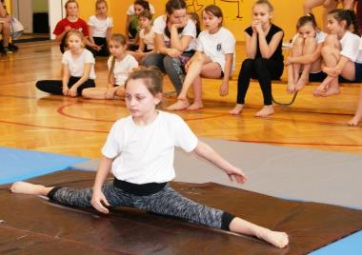

Slide 28
INTERNATIONAL ACTIONS

Slide 29
THE INDEPENDANCE DAY

Slide 30
COMPETITIONS, QUIZES, SHOWS, PERFOMANCES…

Slide 31
THANK YOU
FOR WATCHING!

