Slide 1
ERASMUS+ MOTIVATION III 21st Century Students

Slide 2
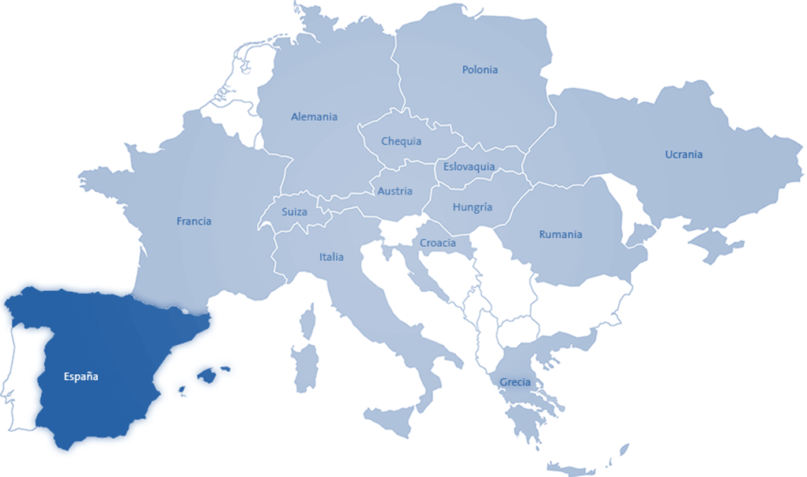
OUR FLAG
OUR CONTRY

Slide 3
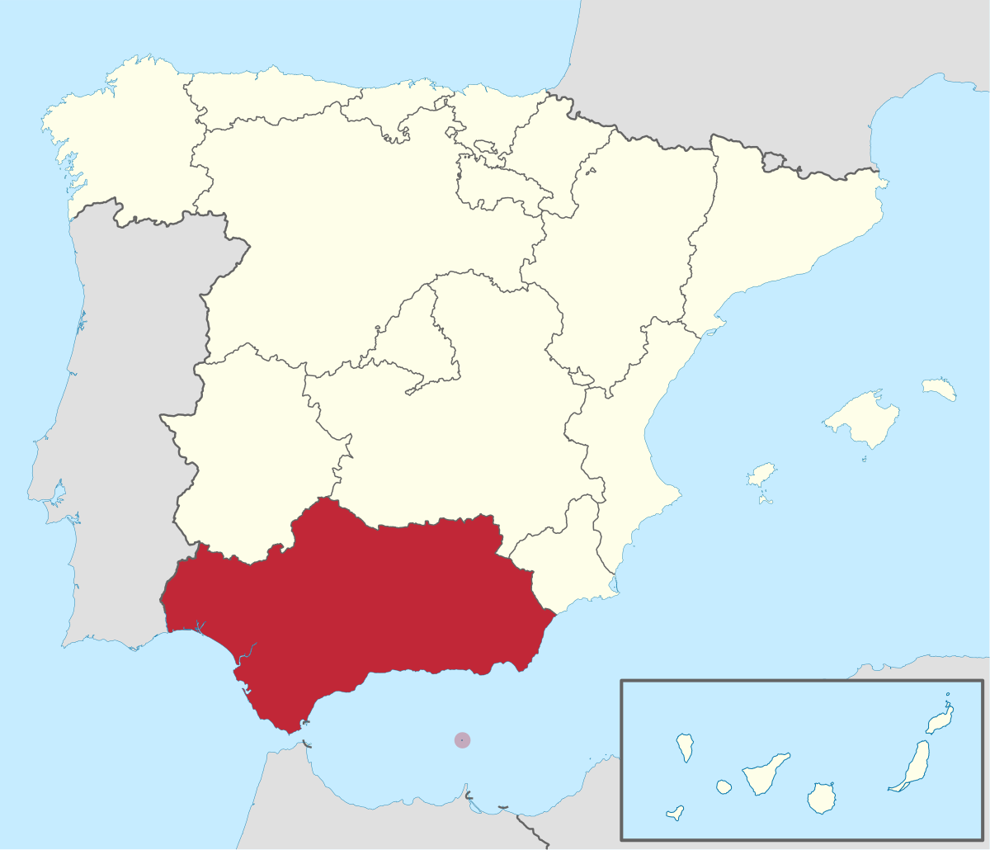
Our region in Spain is called:
ANDALUSIA

Slide 4
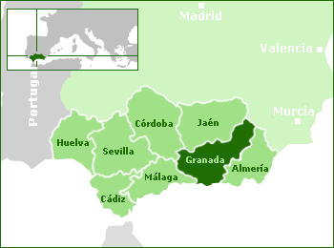
Andalusia has 8 provinces.
Ours is GRANADA

Slide 5
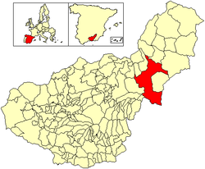
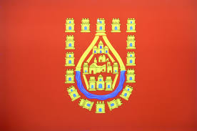
Our city is called BAZA.
It is located in the northeast of Granada

Slide 6
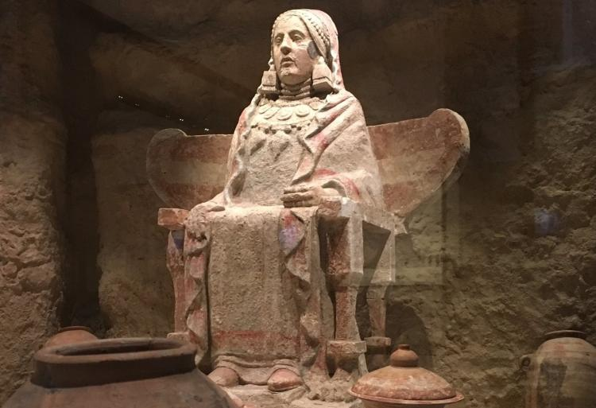
DAMA
DE
BAZA
It is the symbol of our city.
An archaeological
find with a great value.

Slide 7
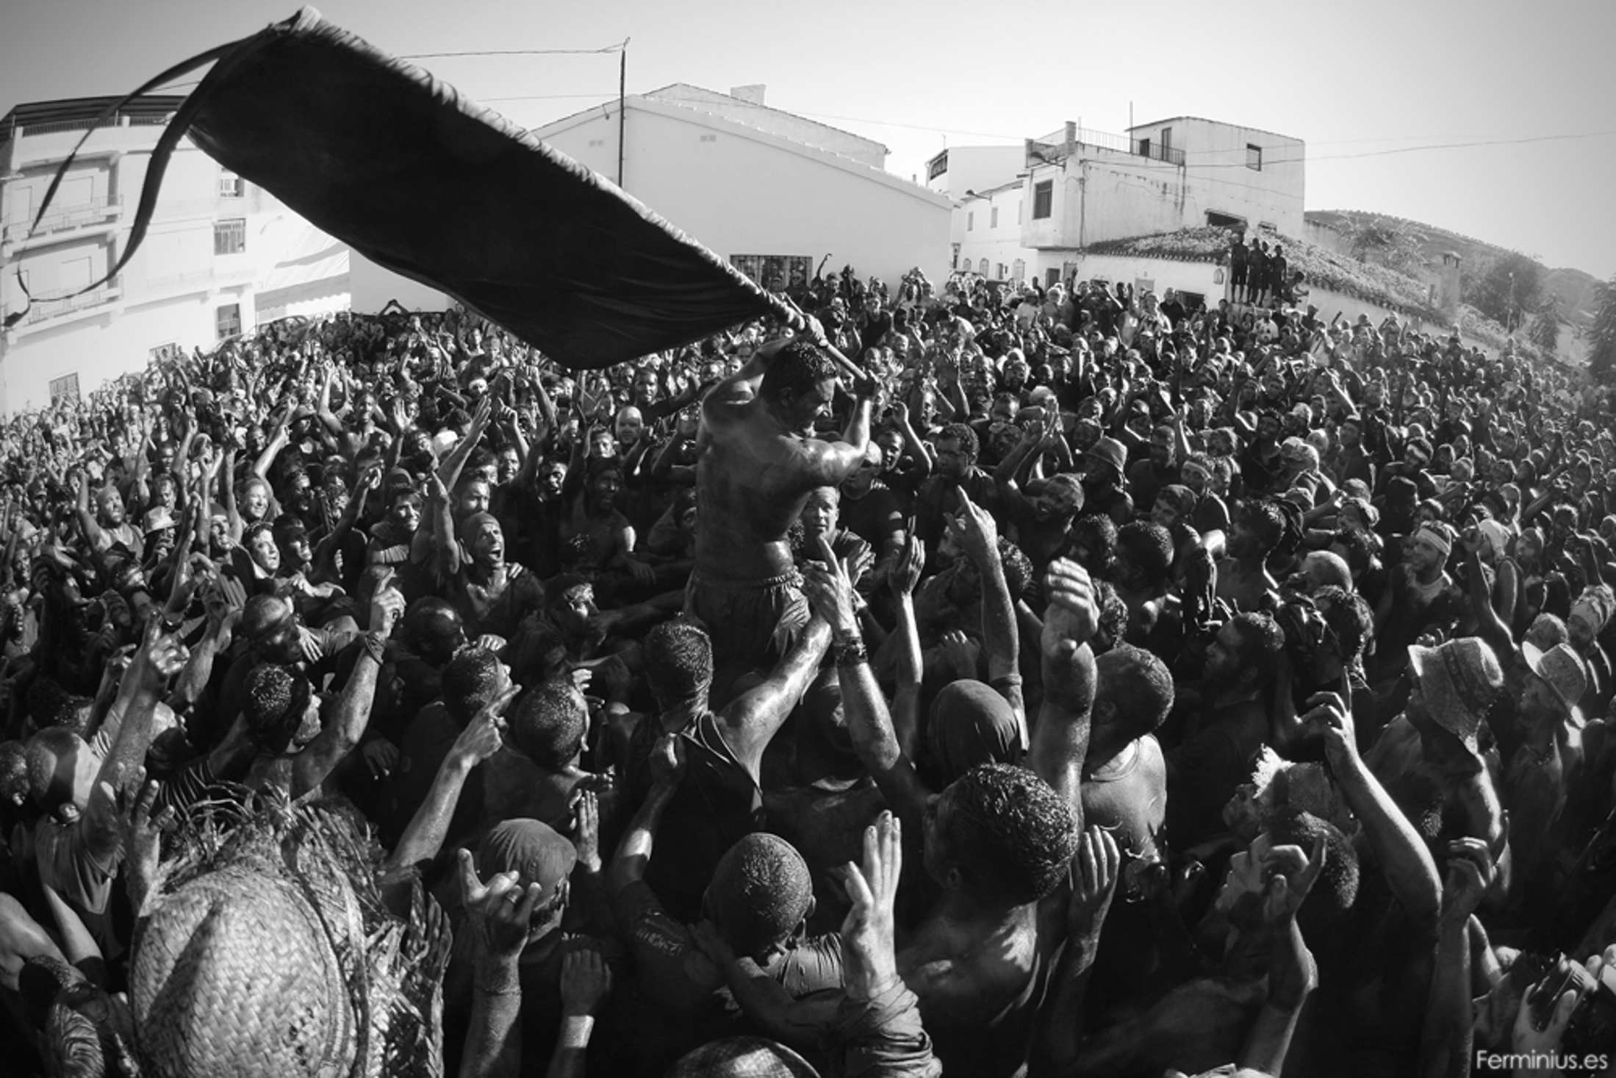
CASCAMORRAS
This party was declared of INTERNATIONAL TOURIST INTEREST in 2013.
Since then,
Baza is visited every 6th September by thousands of people.

Slide 8
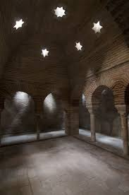
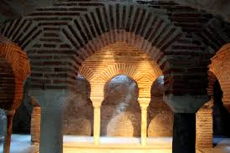
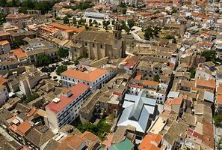
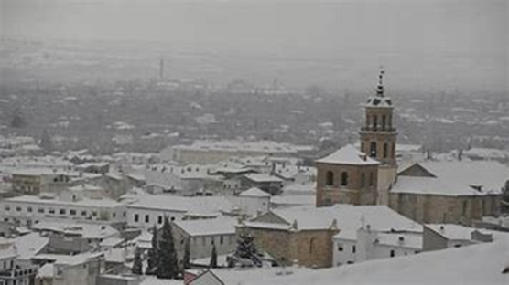
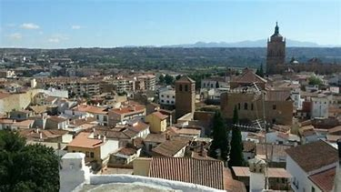
OUR CITY
Baza is the capital of eight municipalities. It has an area of 546km2.
Some of its most important buildings are the Arab baths and the Church of Santa María de la Encarnación.

Slide 9
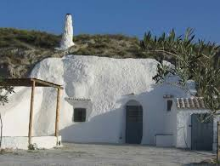
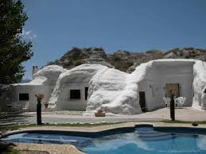
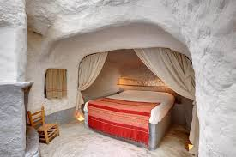
CAVE HOUSES
They are houses excavated in the mountain.

Slide 10
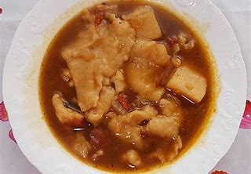
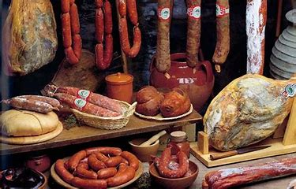
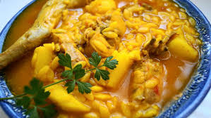
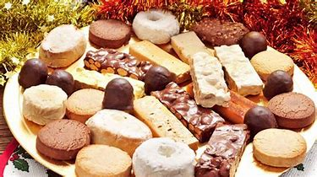
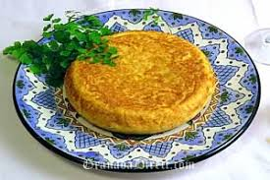
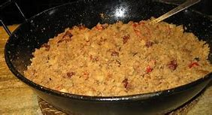
GASTRONOMY
Bastetan gastronomy is very varied. The typical dishes are:
SAUSAGE
GURULLOS
DESSERTS
OMELETTE
MIGAS
GACHASTORTAS

Slide 11
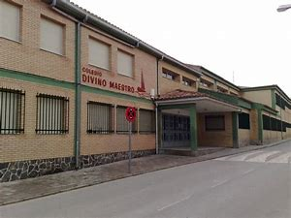
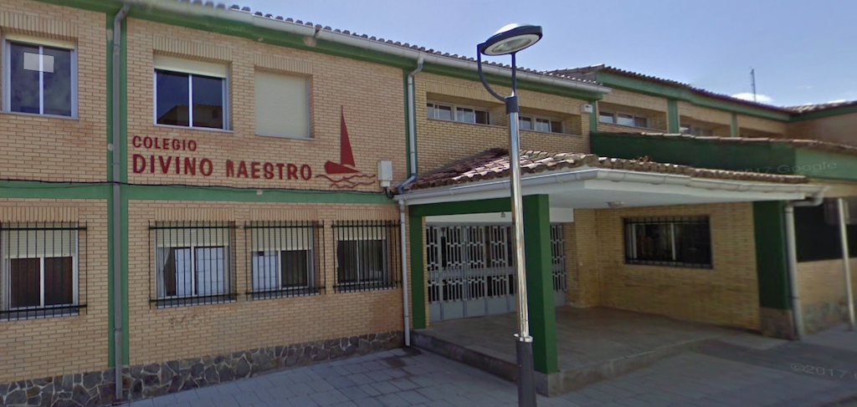
OUR SCHOOL
Our school is located in one of the most humble areas of Baza. It was founded by Francisco Blanco Najera and Madre Soledad in 1944/1945 and after this school was founded, more schools were built around the world in humble and poor areas. This type of school was founded with the idea that the poorest children could have an education.
Now we are very concerned in our school to prevent Early School Leaving, and we believe that by participating in this project, we can improve it.

Slide 12
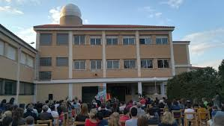
FEATURES
Our school has early childhood education, primary education and secondary education, so the children start in this school at 3 years old and leave at 16 years old.
It is a very small center with only one class per course.
It is a very familiar center, where there is a
very good relationship between teachers and students.

Slide 13
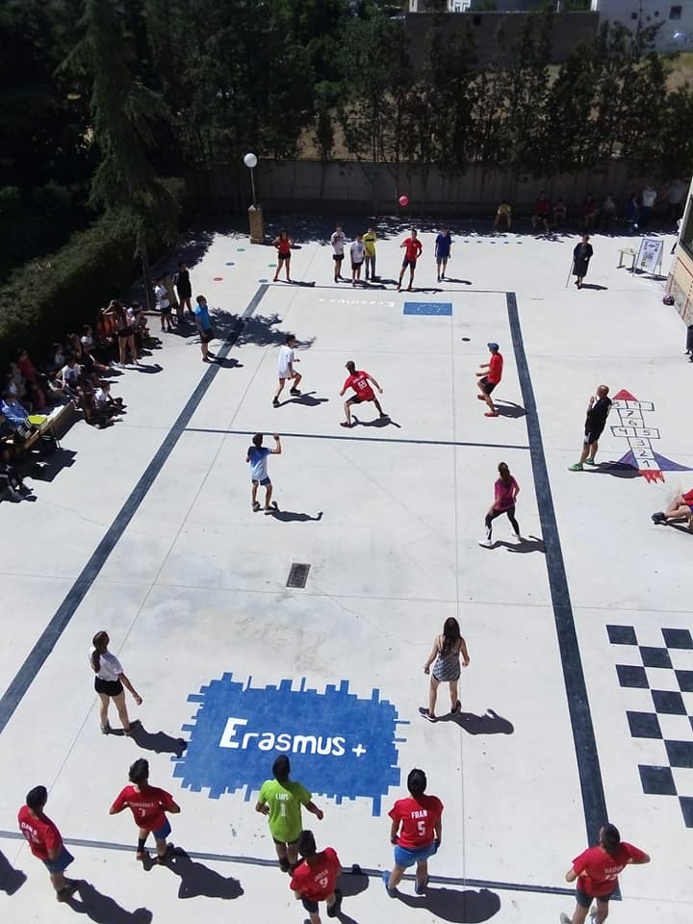
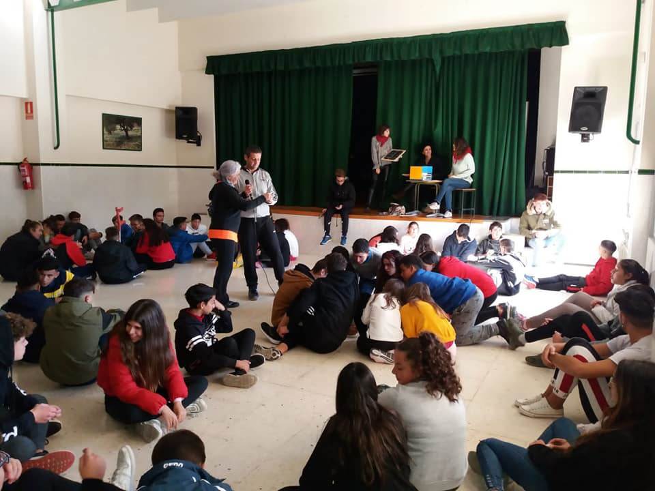
SCHOOL EVENTS
- Missionary leagues
Every year on May, the missionary leagues take place in our school. There are two types of competitions: One of football and one of a tipycal game of Baza called “Quema”.
The day of the school
The day of the school is celebrated every year on the 12th of November because it was the day on which school was founded. All the children play games and eat chocolate and cake together.

Slide 14
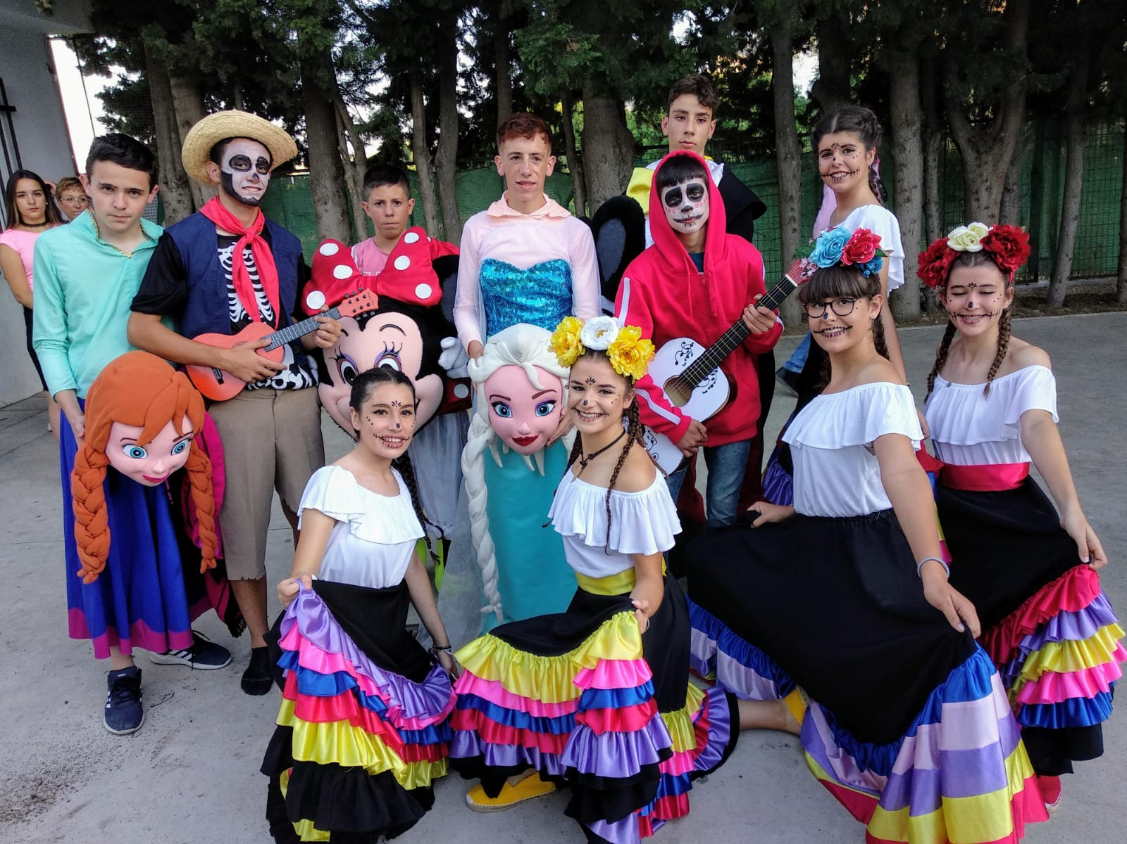
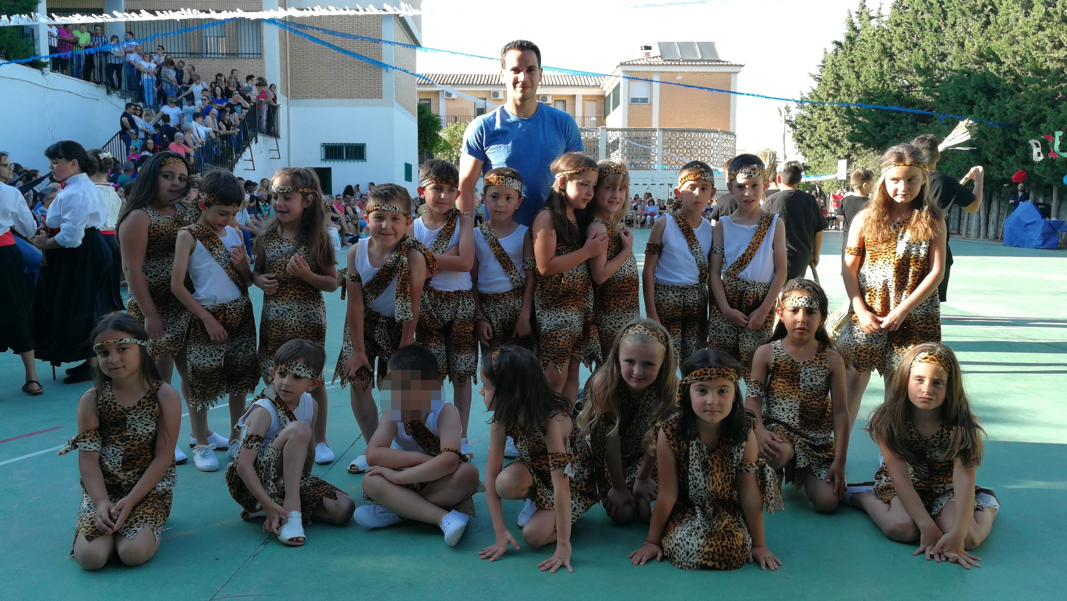
SCHOOL EVENTS
End-of-year
The end of the course is a festival celebrated on the last day of the course where all the students dance different types of songs.

Slide 15
We hope see you soon in Baza (Spain)

