Slide 1
MOTIVATION III - 21st CENTURY STUDENTS

Slide 2
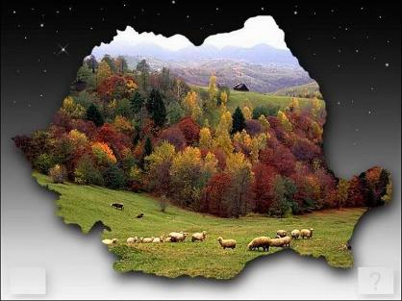
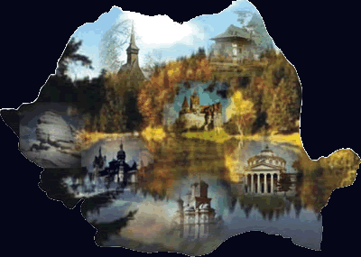
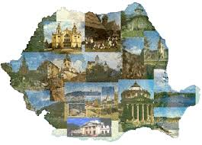
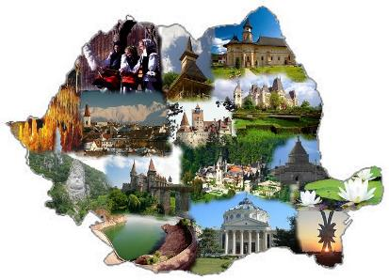
WELCOME TO ROMANIA

Slide 3
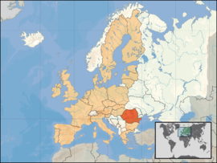
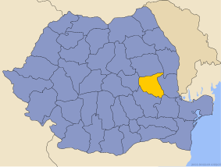
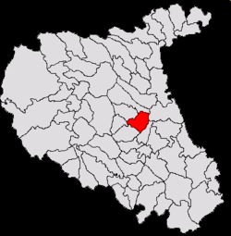
EUROPA- ROMANIA-VRANCEA-ŢIFEŞTI

Slide 4
ROMANIA
Romania is a country located in south-eastern Central Europe, on the Lower Danube, north of the Balkan Peninsula and the northwestern coast of the Black Sea. Romania’s neighbors are Bulgaria (south), Serbia (southwest), Hungary(west), Ukraine (north and east) and Moldova ( east) and the Black Sea( to the southeast).
National Holiday – 1st December
Romania’s Flag
Currency:1 Ron
Official language :Romanian

Slide 5
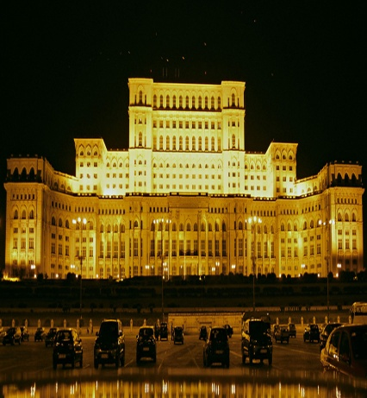
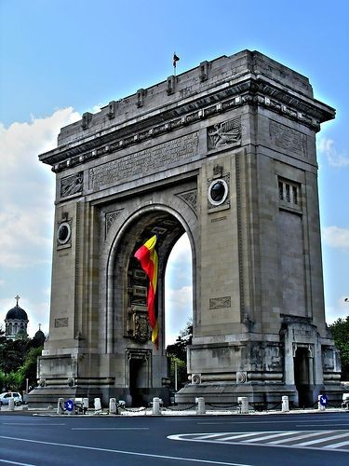
BUCHAREST -THE CAPITAL OF ROMANIA
Bucharest is Romania's capital and at the same time, the most populous city and the most important industrial and commercial center of the country. Bucharest is the tenth city in population in the European Union . It is also known as “Little Paris”.
People’s House
Arch of Triumph

Slide 6
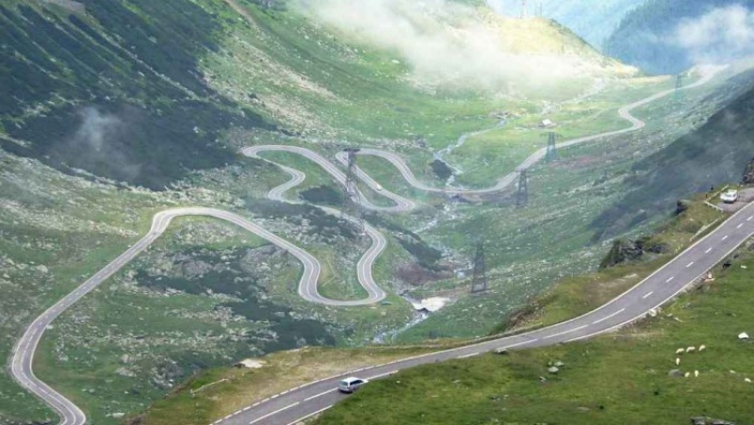
TransfagArasanul- one of the highest road in the country The Transfagarasan mountain road is one of the most spectacular roads in the world.

Slide 7
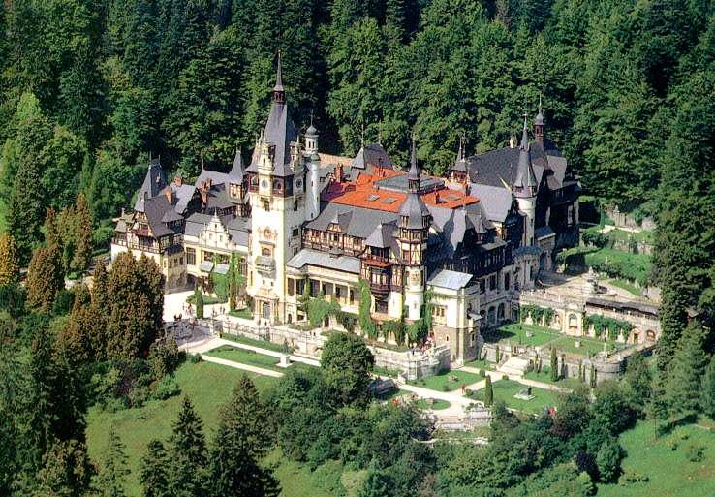
PELES CASTLE from SINAIA King Charles I built his summer home, known as Peles Castle; it also is a popular tourist attraction.

Slide 8
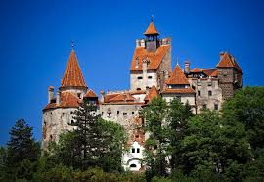
Bran Castle It is situated near Bran ,it ‘s a national monument and landmark in Romania. It is known as "Dracula's Castle" .

Slide 9
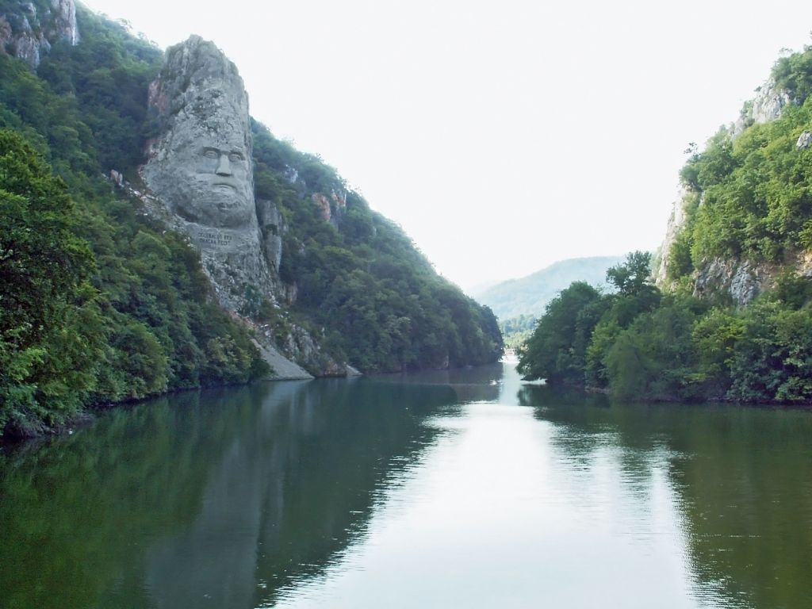
Decebal ‘s Head – overlooking the Danube river

Slide 10
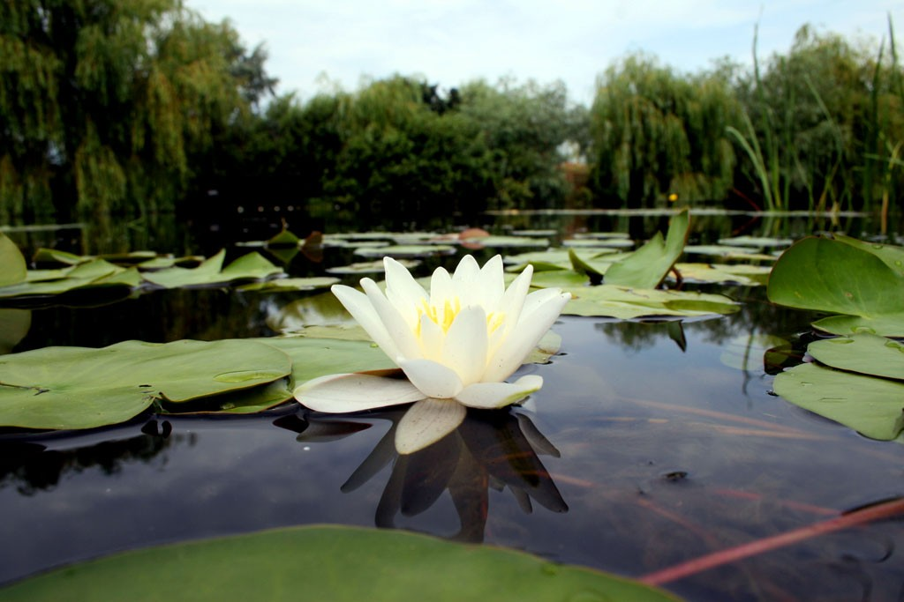

Slide 11
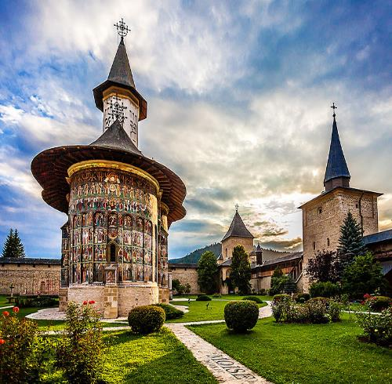
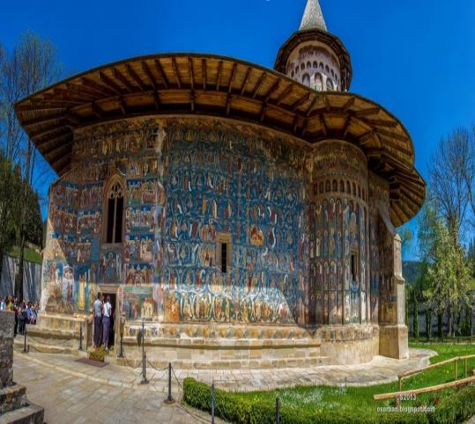
MONASTERIES OF BUCOVINA
Among the most picturesque treasures of Romania are the Painted Monasteries of Bucovina .Their painted exterior walls are decorated with elaborate 15th and 16th century frescoes featuring portraits of saints and prophets, scenes from the life of Jesus.
SUCEVIȚA MONASTERY
VORONET MONASTERY

Slide 12
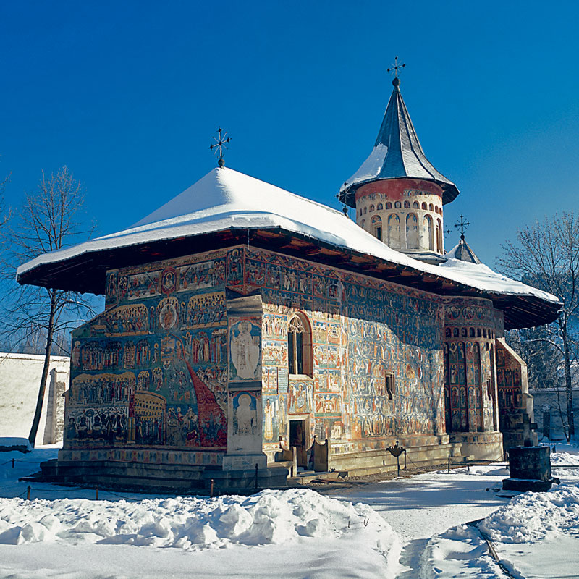
Monastery Sucevita - Suceava, Inscribed on UNESCO world cultural heritage list..

Slide 13
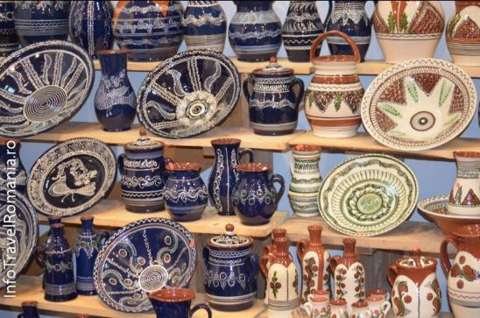
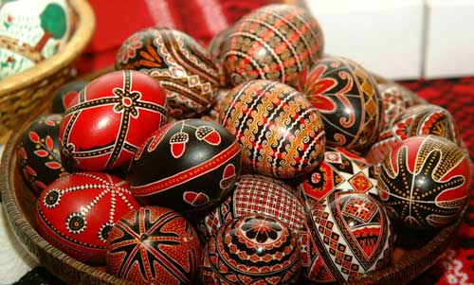
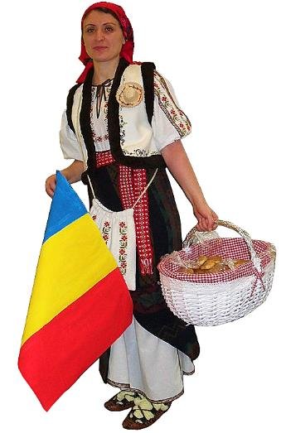
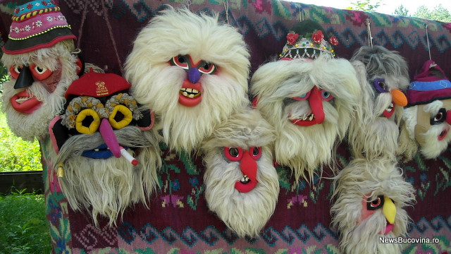
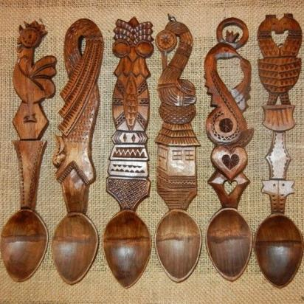
CUSTOMS AND TRADITIONS
The Romanian culture is very rich in tradition and folklore. Wood carvings, skilfully woven carpets, and pottery are some of the elements of traditional Romanian culture.
Special folk arts of Romania are the decorated Easter eggs and painted glass.

Slide 14
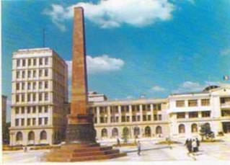
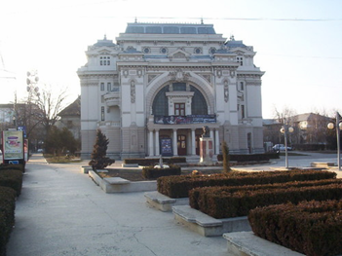
FocSani
Focsani is the capital and largest city of Vrancea County , Romania. In many writings called "City of Milcov" River that “Stephen the Great “established the border between Moldova and the Romanian Country in 1482.

Slide 15
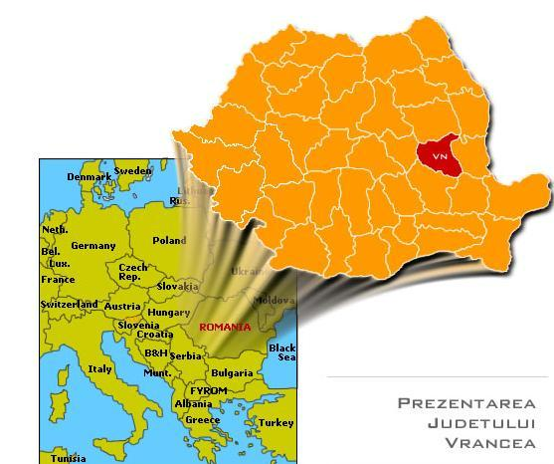
2016- 2018
THE LANDS OF VRANCEA
,, …Vrancea county, a land of bold people,
keepers of traditions of their ancestors ,
who, for centuries have defended their freedom and independence.”
(Alecu Russo - ,, Cântarea României”)

Slide 16
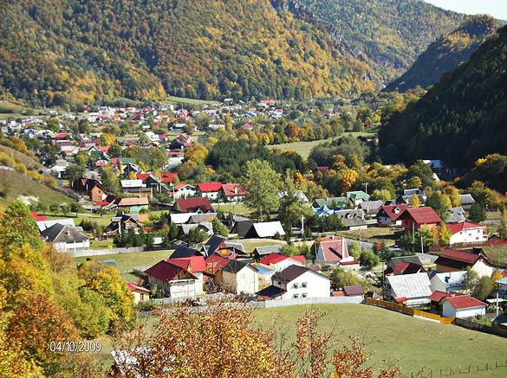

Slide 17
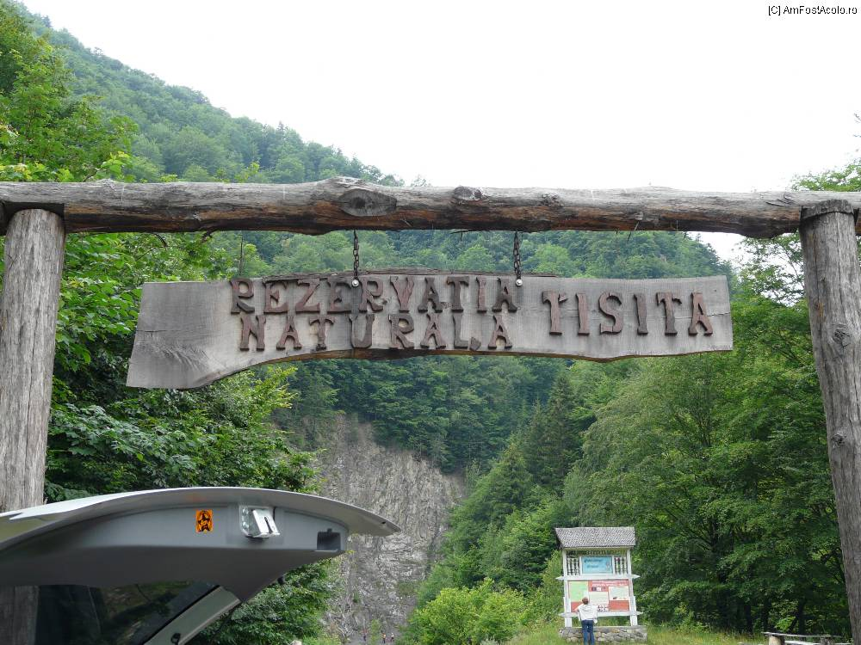
The Lands of Lepșa- Tișița’s Keys Reservation
The Reservation Tișița’ s Keys, a natural protected area, is one of the most beautiful and interesting areas in Vrancea.

Slide 18
Lepșa- Putna Waterfall

Slide 19
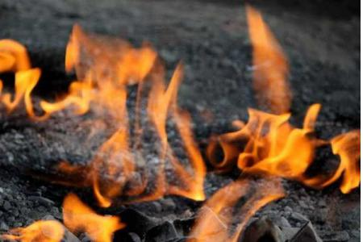
The Living Fire- Andreiașu de Jos
Right under the lower limit of a very beautiful fir tree forest, a very rare natural phenomenon can be seen - the living fires.

Slide 20
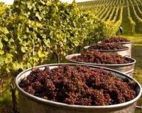
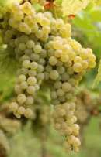
The land of the vigneards
Panciu - Odobesti vineyard, one of largest and oldest in Romania. The wide variety of wines produced by the Odobesti vineyard makes it the most traditional wine-growing area in Romania, with six traditional sorts of Romanian wine, namely: Galbena de Odobesti, Plavaie, Feteasca Alba, and Feteasca Regala (white wines) and Babeasca neagra (red wines).

Slide 21
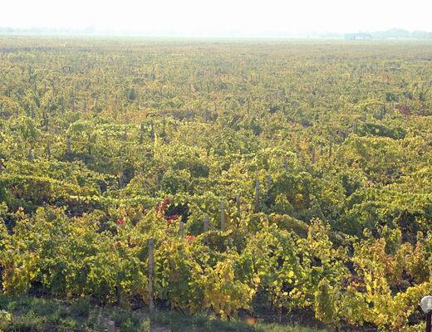
TIFESTI VILLAGE
There are 5222 people living in the villages of Tifesti Commune.
The Tifesti vineyard is an important region for the wine industry. Agriculture is the main occupation of the population.

Slide 22
The village Tifesti is also known as “the village between the rivers”. Ţifeşti is a commune located in Vrancea County, Romania. It is composed of eight villages.

Slide 23
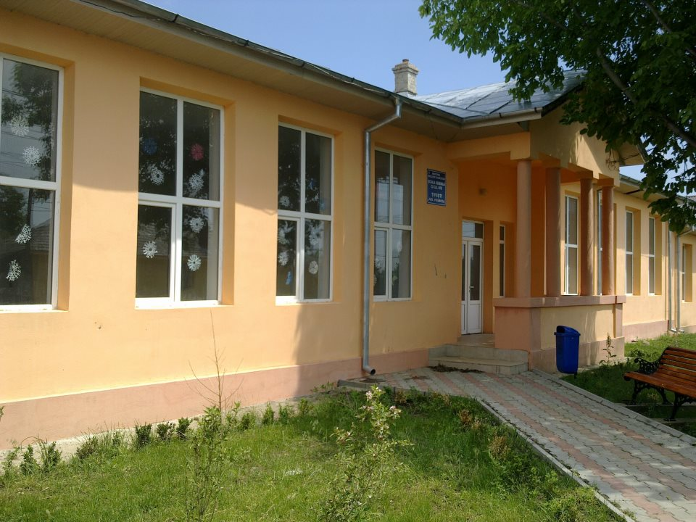
TIFESTI SCHOOL
School exists since 1864 and since then it is the soul of our community.
Our school is a source of energy, beauty and knowledge for our community.

Slide 24
PHOTOGHAPHY CLUB we invited a profesional photographer in our school to talk to our students about art of photography,how to use a good light for taking photos.

Slide 25
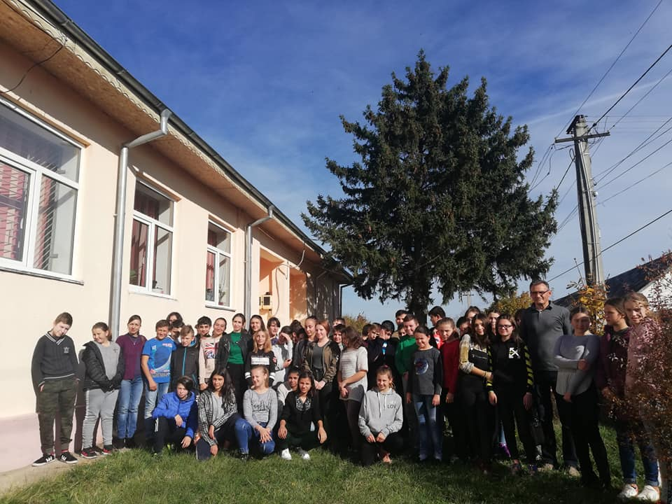

Slide 26
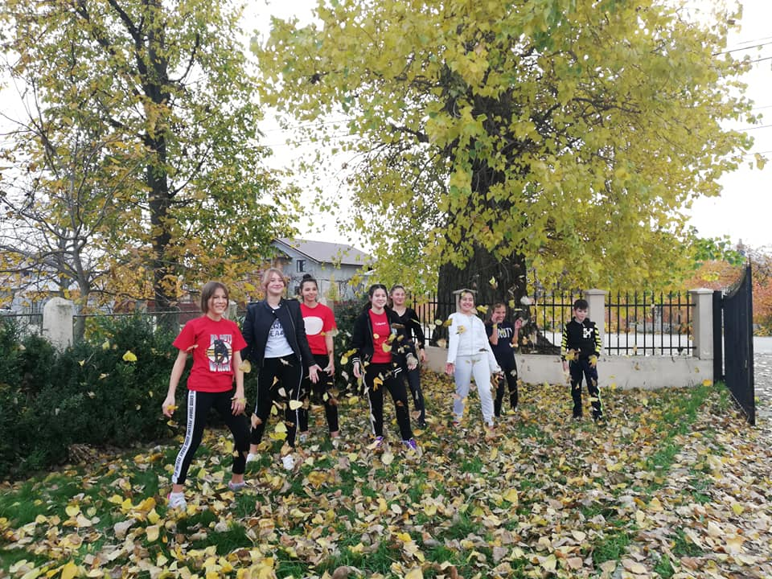

Slide 27
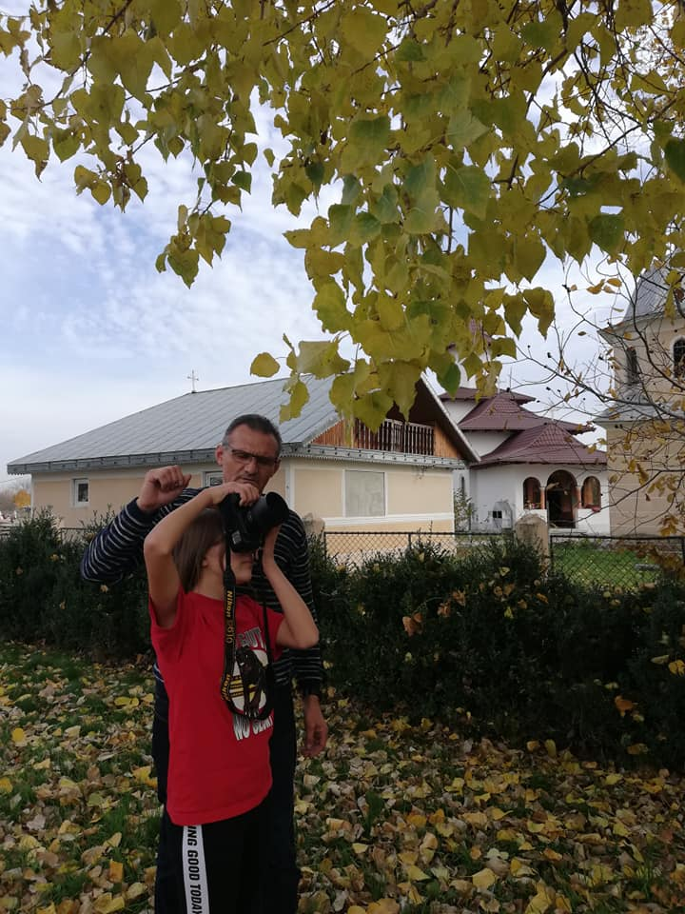

Slide 28
Beauty of autumn

Slide 29
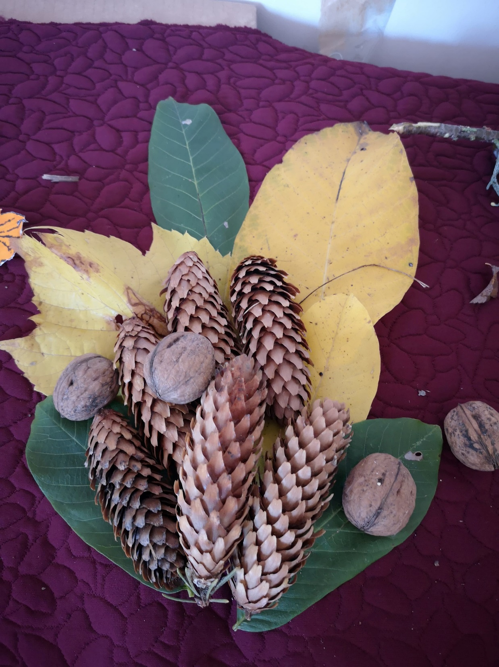

Slide 30
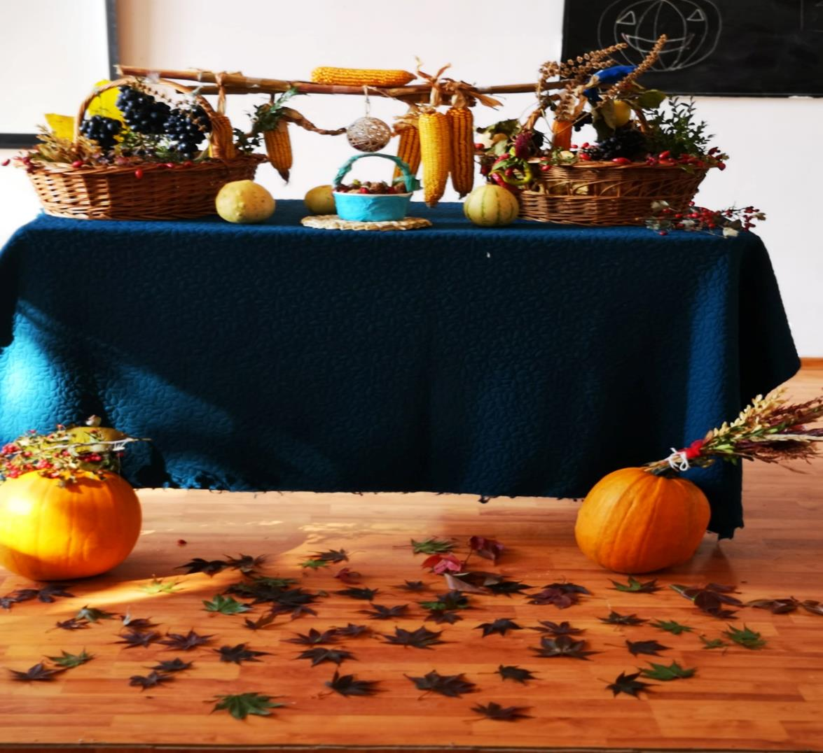

Slide 31
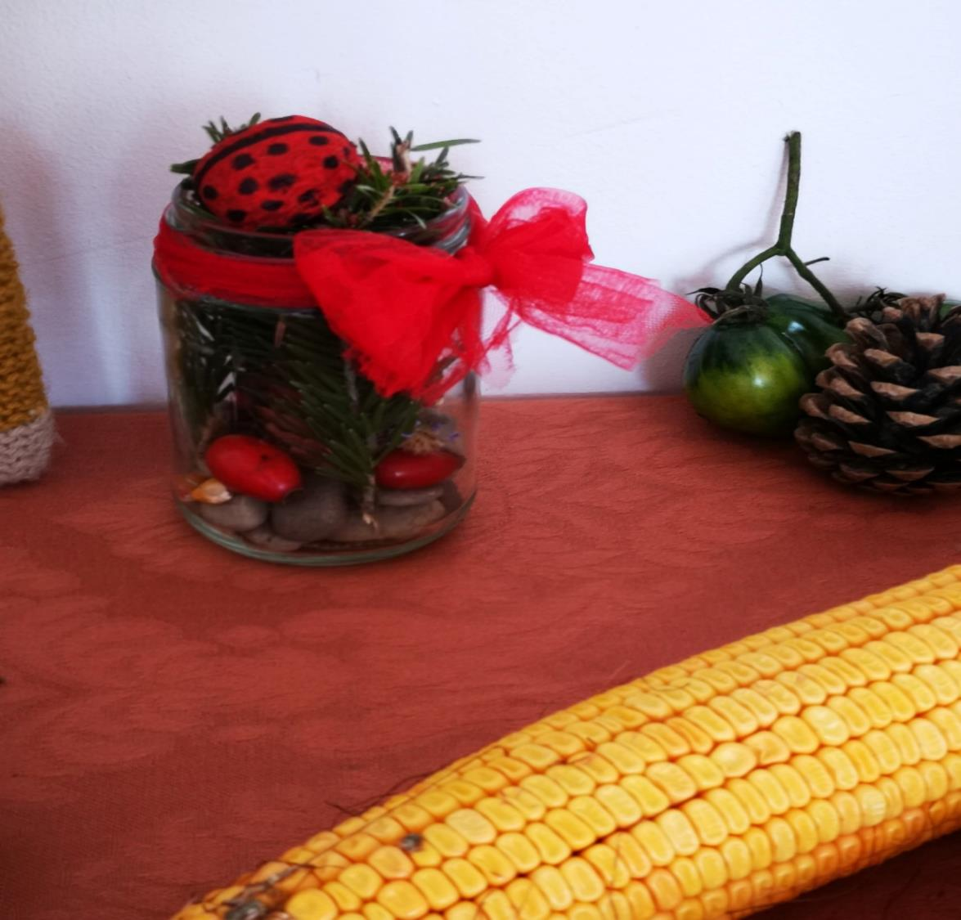

Slide 32
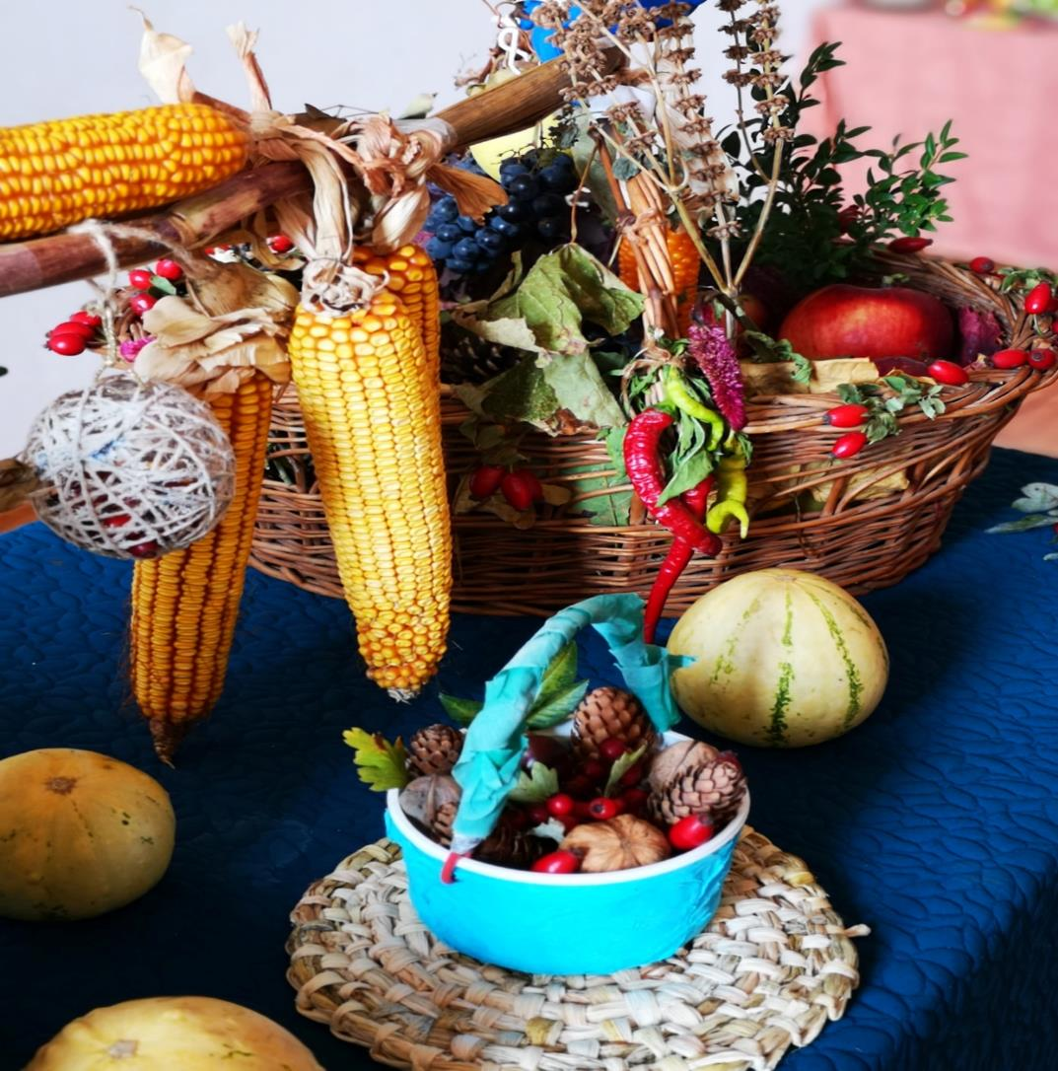

Slide 33
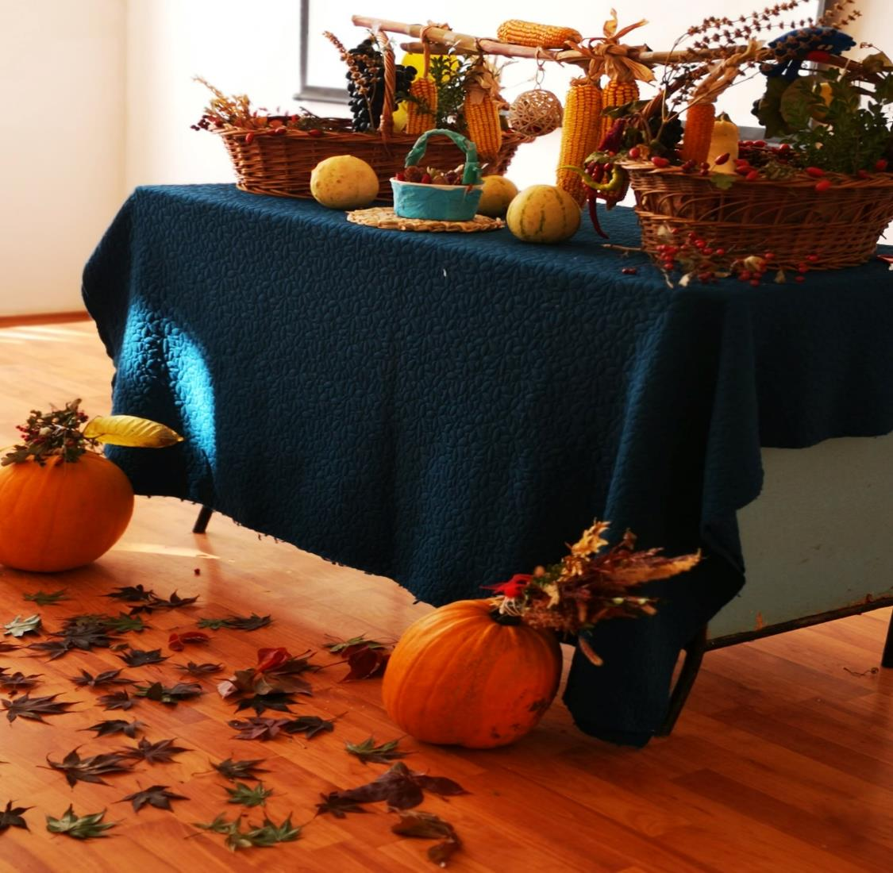

Slide 34
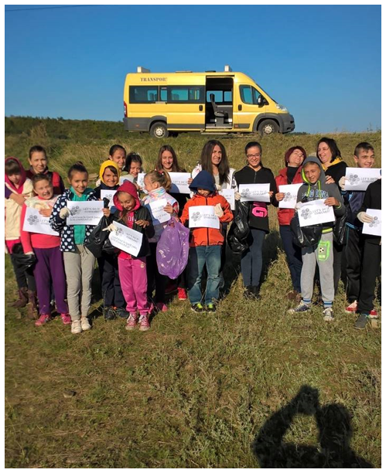
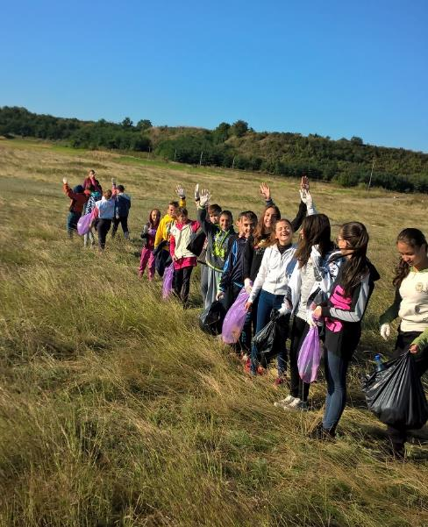
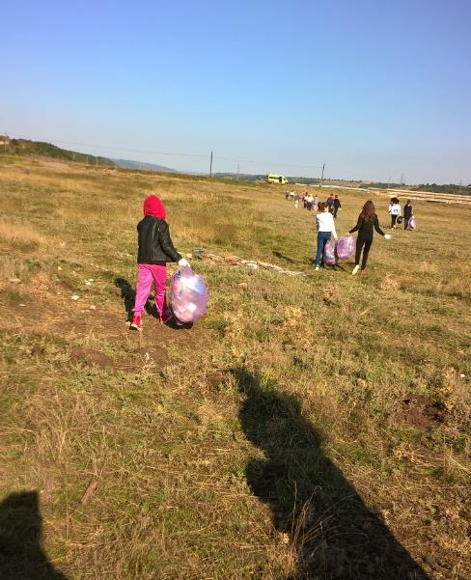

Slide 35
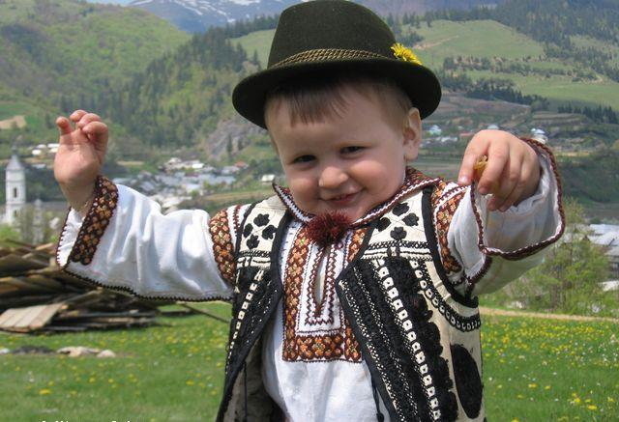
WE ARE WAITING IN ROMANIA!

